Slide 1
Astronomy: Navigation and Culture
Grade 9 Science

Slide 2
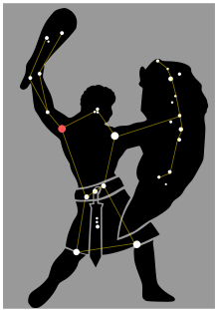
Orion
Named after a hunter in Greek Mythology
Most visible between January and April
*Earliest known depiction or drawings date back over 30,000 years
Egyptians considered this constellation to be a god which they called ”Sah”
The North American Ojibwa or Anishinaabe people called this constellation Kabibona’kan, which meant “winter maker” hence its presence in the winter night sky

Slide 3
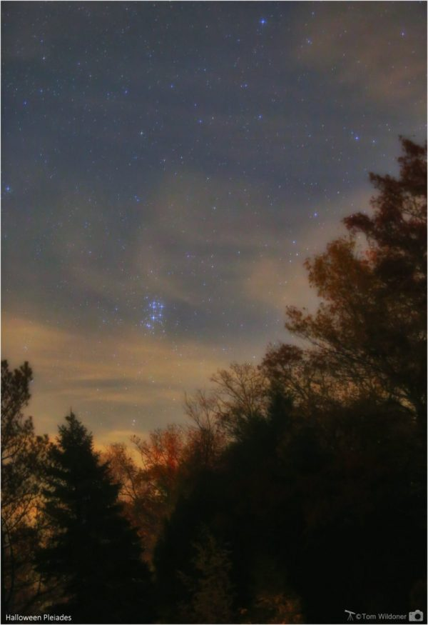
Pleiades (Seven Sisters)
Visible between October and May
*In ancient times, many cultures used Pleiades location as an indicator for the end of farming and sailing season (North American Indigenous, European, Egyptian etc.)
Can usually only see 6 out of 7 stars, this is due to the variability of the brightness of the 7th star
Many cultures have their own version of why the 7th star disappeared as it used to be brighter in ancient times
Fun Fact: used as the logo for the automobile company “Subaru”

Slide 4
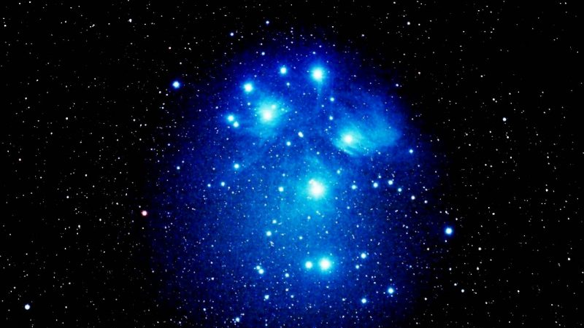
Pleiades and Halloween
Halloween originated from the Celtic festival of Samhain
Approximately 2,000 years ago the Celts celebrated their new year on November 1.
They celebrated the end of the harvest season before the long winter
They believed that the on eve of November 1st (October 31st), the barrier between the dead and the living was considered minimal or more open
They believed this because Pleiades is at its highest point in the sky at midnight on October 31st

Slide 5
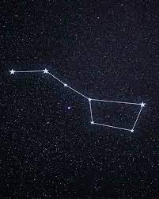
Ursa Major (Big Dipper)
Has been used to locate the north star for hundreds of years
*In many Indigenous cultures, the Big Dipper represents a bear with three hunters following it
In Arabian culture it is considered a constellation associated with funerals. The cup is a coffin, and the handle is three mourners following it.

Slide 6
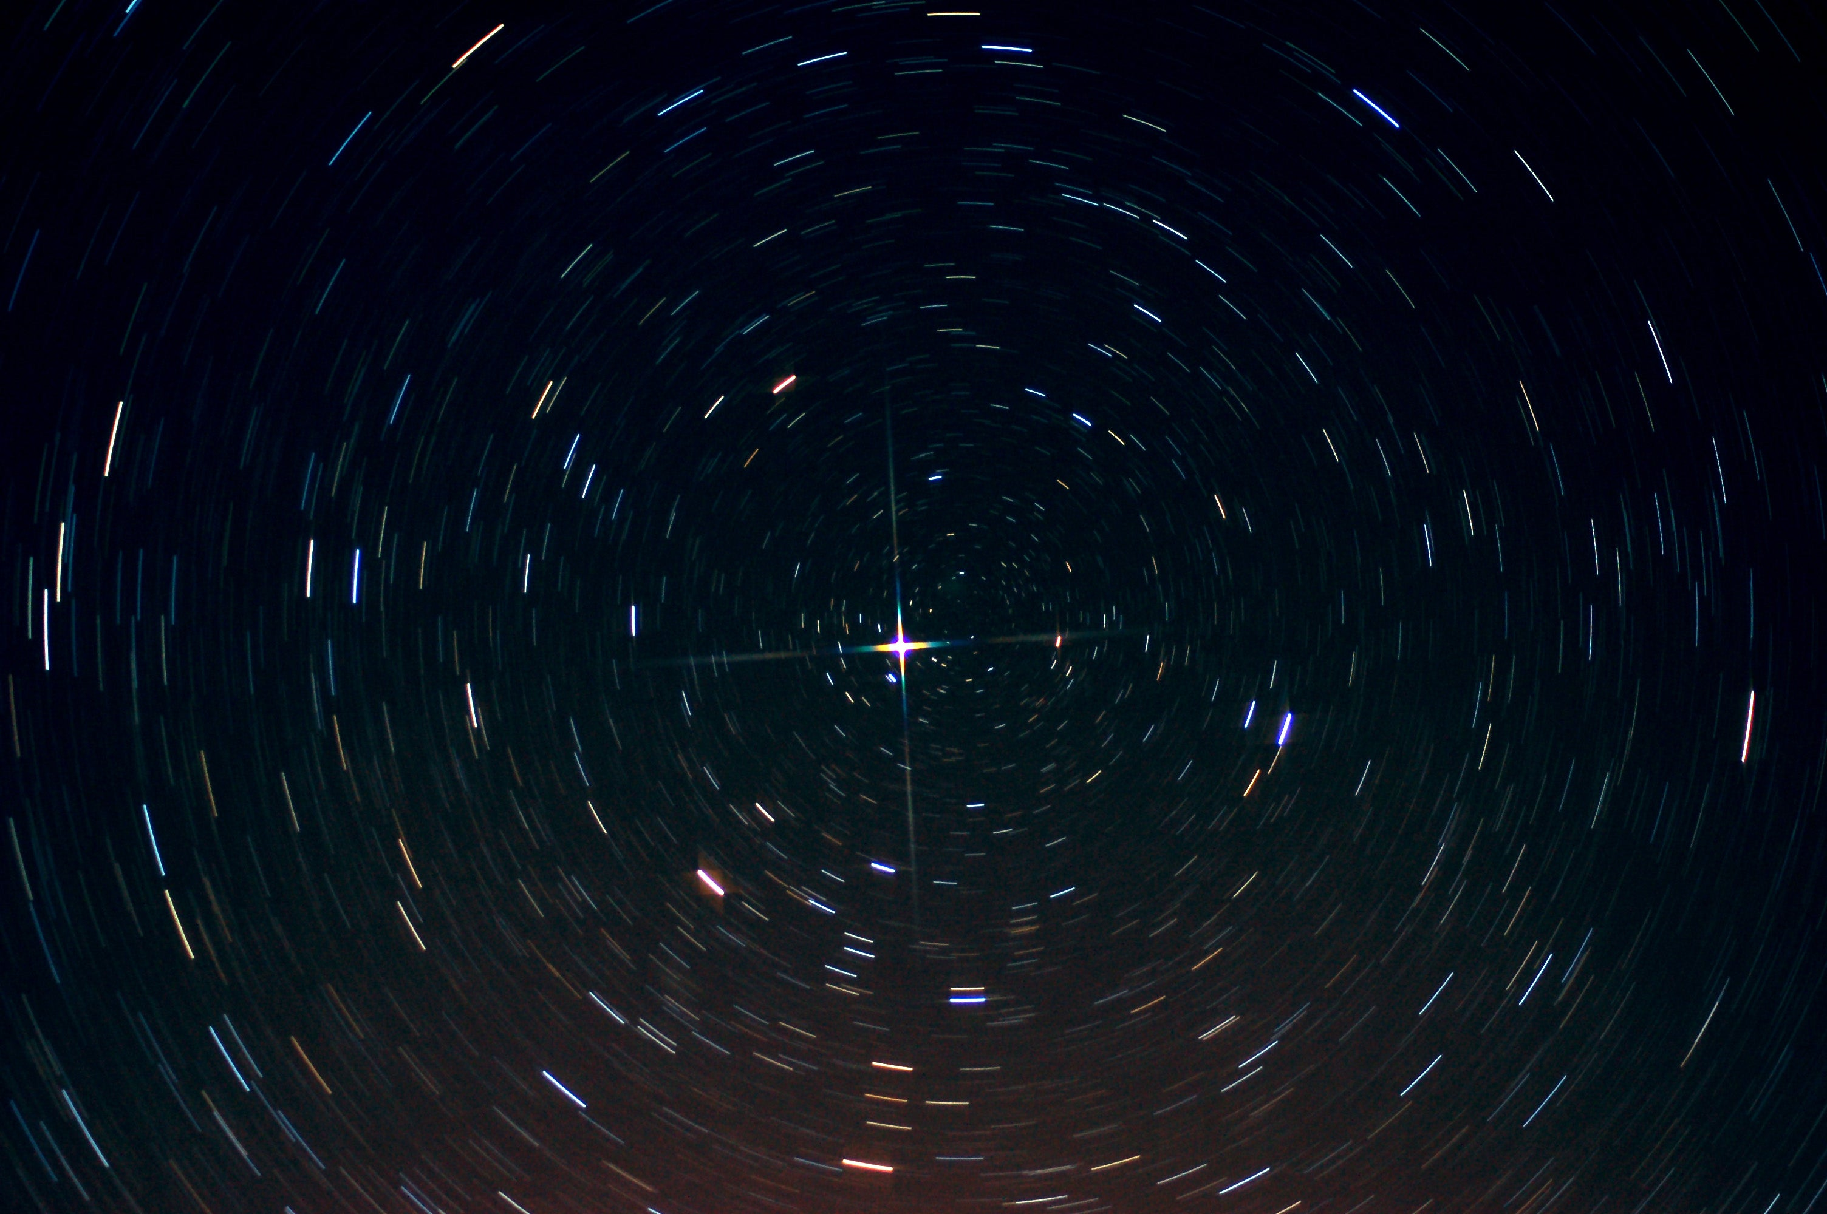
North Star
The north star is called “Polaris”
It is the last star on the handle of the Little Dipper Constellation
*You can find it by using the last two stars on the big dipper, they point directly to Polaris

Slide 7
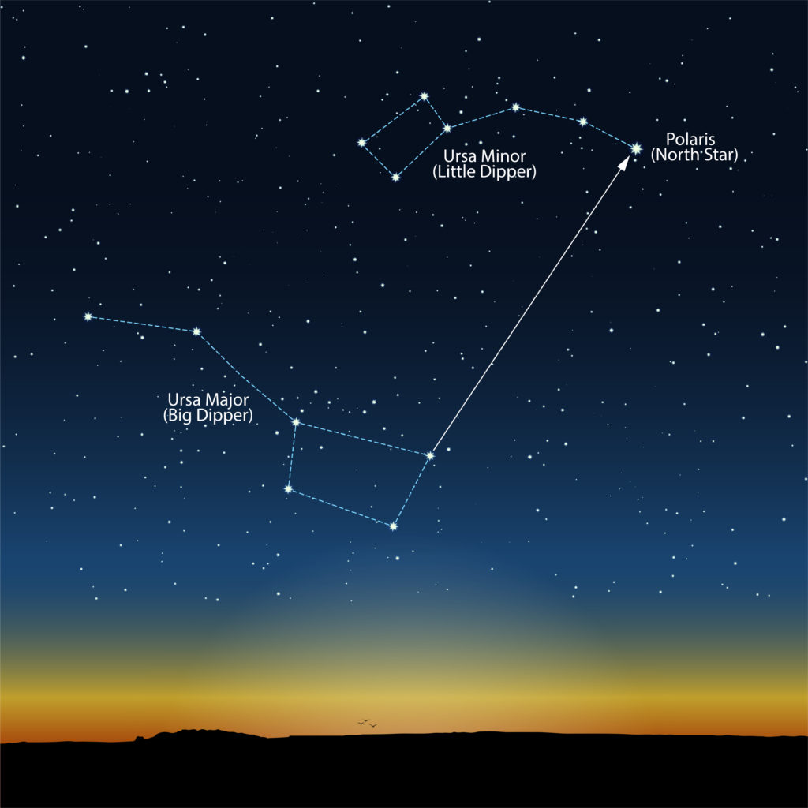

Slide 8
Polaris video
Arizona night sky video

Slide 9
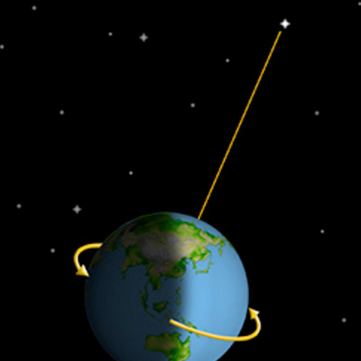
Why is the North Star always North
*The North Star is always north because it is very close to the celestial north pole
The celestial north pole refers to the point in the sky that is directly above the earth’s north pole
As the earth rotates, the other stars will “move” in our night, while Polaris or the north star, stays in the same spot

Slide 10
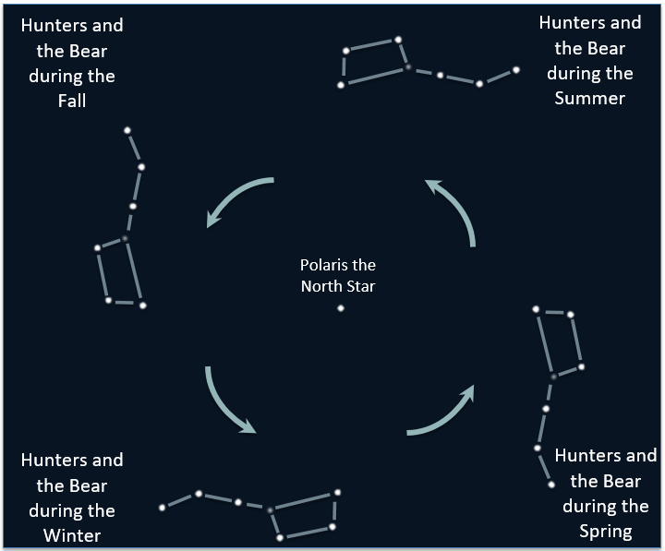

Slide 11
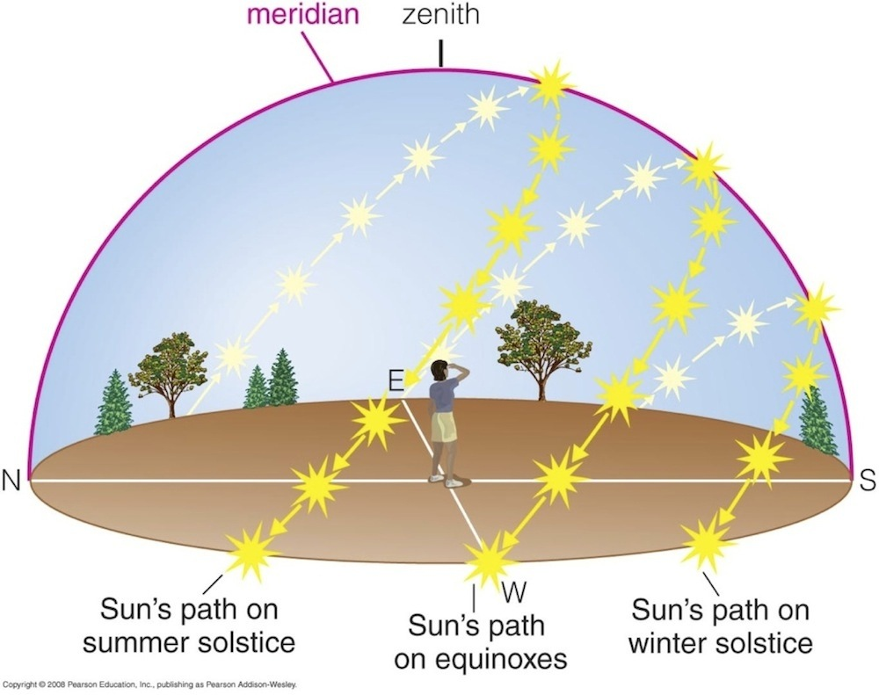
Navigation using the Sun
The sun rises in the east and sets in west
This is is because the earth spins towards the east
This spin towards the east also causes our moon and all the planets and stars in our sky to move east to west as well

Slide 12
References
https://climate.nasa.gov/news/2948/milankovitch-orbital-cycles-and-their-role-in-earths-climate/#:~:text=Earth's%20axis%20is%20currently%20tilted,about%209%2C800%20years%20from%20now.

